Slide 1
PREDICTION OF DIAMOND PRICES
Vignesh Tirumalai
Mohit Mhapuskar
Ayush Kaushik

Slide 2

OVERVIEW
The Four C’s
The quality of diamonds are determined by what are popularly known as the four C’s.
Carat: Carat is the primary indicator of the size of a diamond.
Color: Color ratings range from colorless to slightly tinted.
Cut: Cut determines the brilliance or sparkle of the diamond.
Clarity: The amount of inclusions or flaws in the diamond. Can range from flawless to included.

Slide 3
OVERVIEW
These four parameters determine the value of a diamond in one way or another.
Customers and jewelers may often end up valuing one over the other.
Which combination of these parameters can best predict the price of diamonds?

Slide 4

PROJECT SUMMARY
DATASET
PROJECT PLAN
PROJECT GOAL
Dataset contains prices and other attributes for about 54,000 diamonds. Obtained from www.kaggle.com.
Analyze the diamond data and provide insights that can help reduce the number of misinformed people about the prices of diamonds.
To create a model which can accurately predict the prices of diamonds using its characteristics.

Slide 5

1. DATA UNDERSTANDING

Slide 6
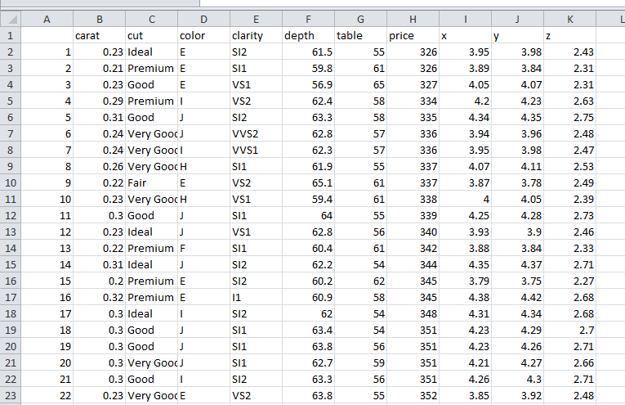
DATA UNDERSTANDING

Slide 7

DATA UNDERSTANDING
The dataset contains 53940 records of diamonds and 10 columns/attributes for each diamond. The following is a list of variables in the dataset.
Variable Name | Variable Description
Carat | Describes the weight of the diamond.
Cut | Describes the cut quality grade of the diamond in increasing order from Fair, Good, Very Good, Premium, Ideal.
Color | Color of the diamond as a grade. Grades range from ‘D’ being the best to ‘J’ being the worst.
Clarity | Level of inclusions in the diamond as a grade. Grades range from ‘FL’=flawless to ‘l3’=level 3 inclusion

Slide 8
DATA UNDERSTANDING
Depth | Depth%: The height of the diamond divided by average girdle diameter.
Table | The width of the diamond’s table expressed as a percentage of its average girdle diameter.
x | Variable x denotes the length of the diamond in mm.
y | Variable y denotes the width of the diamond in mm.
z | Variable z denotes the depth of the diamond in mm.
Price | The price of the diamond in USD. Target variable.

Slide 9
2. DATA PREPROCESSING

Slide 10
DATA PREPROCESSING
0
2672
50%
Missing values in the dataset.
Outliers were removed from the dataset.
Split of data into training data and test data.

Slide 11
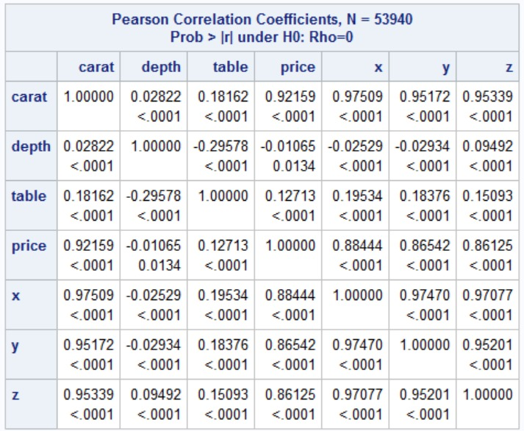
CORRELATION MATRIX
Predictors that highly correlate with our target variable price are as follows
Carat
X (length in mm)
Y (width in mm)
Z (depth in mm)

Slide 12
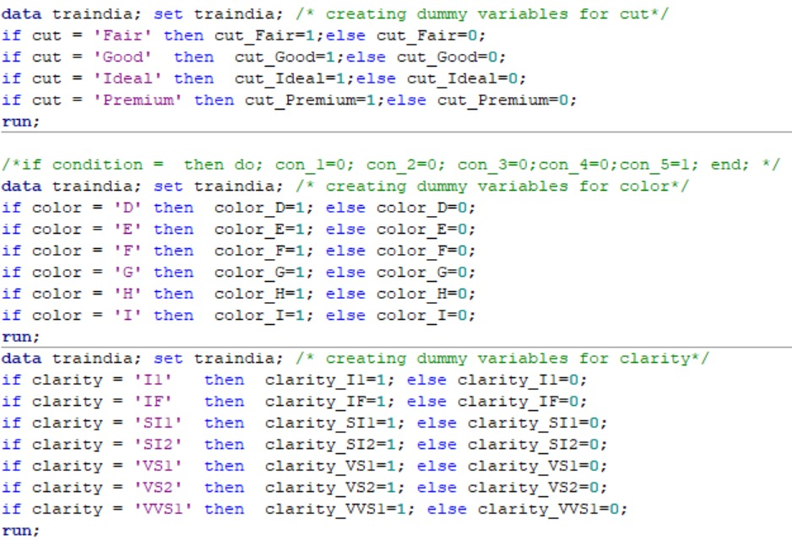
DATA PREPROCESSING
DUMMY VARIABLE CREATION
Since 3 of our predictors, namely color, cut and clarity are categorical variables with non-binary values, we create dummy variables with binary values for N-1 categories for each of the 3 variables.

Slide 13

DATA PREPROCESSING
DATA NORMALIZATION
As the variables carat, depth, table, x, y and z do not satisfy a normal distribution we standardize them before proceeding to analysis.

Slide 14
3. EXPLORATORY DATA
ANALYSIS

Slide 15
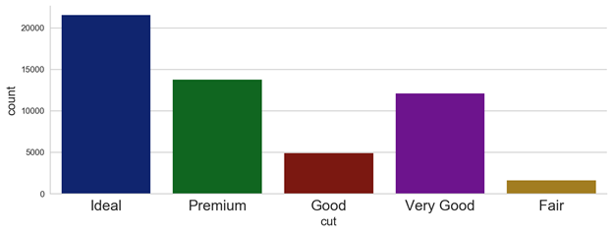
EXPLORATORY DATA ANALYSIS

Slide 16
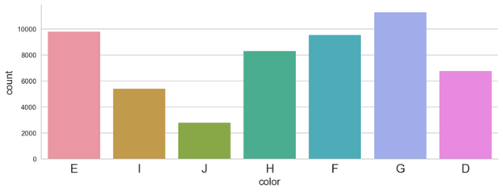
EXPLORATORY DATA ANALYSIS

Slide 17
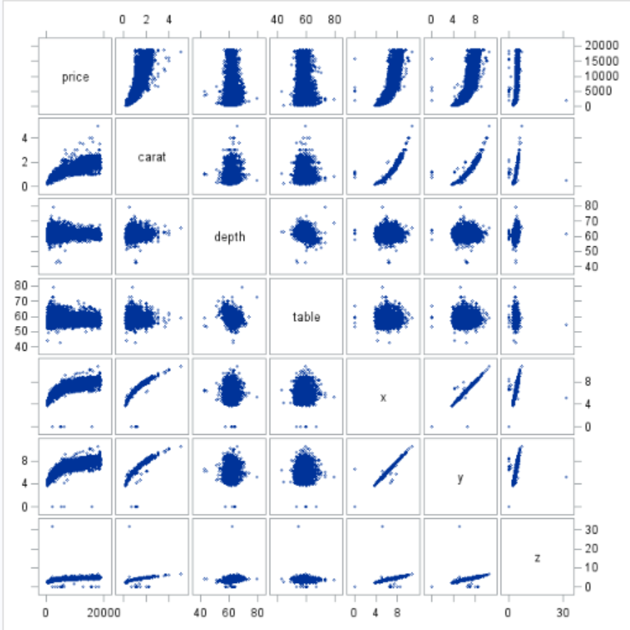
EXPLORATORY DATA ANALYSIS

Slide 18
4. ANALYSIS

Slide 19
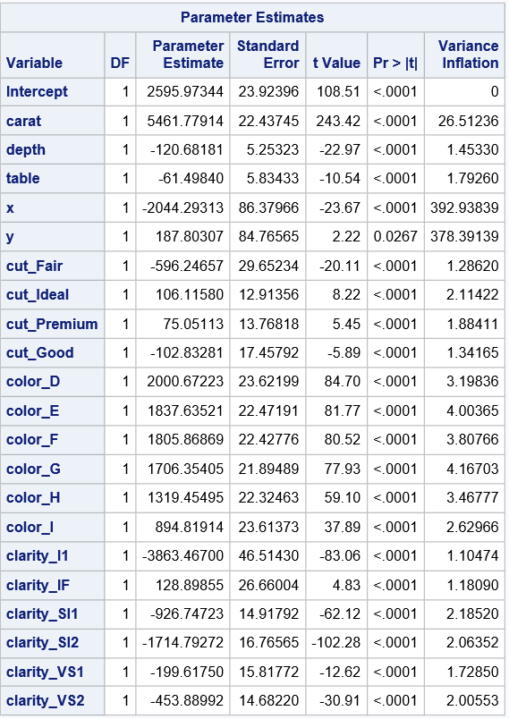
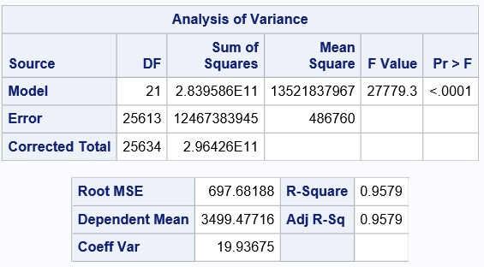
ANALYSIS
FORWARD SELECTION
Variables meeting the 95% significance criteria enter the model at each stage of selection.

Slide 20


ANALYSIS
BACKWARD ELIMINATION
Variables not meeting the 95% significance criteria leave the model at each stage of elimination.

Slide 21
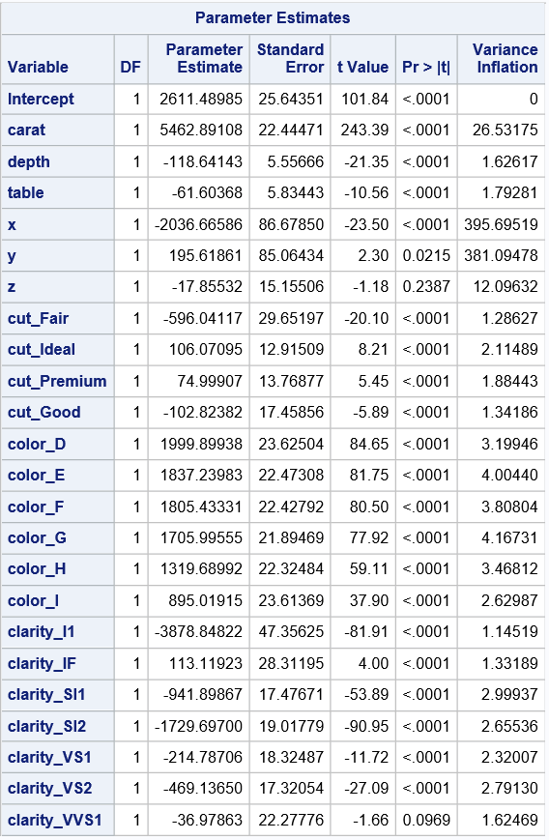

ANALYSIS
MAXR SELECTION
Variables that most improve the R-square value enter at each stage of MAXR selection.

Slide 22
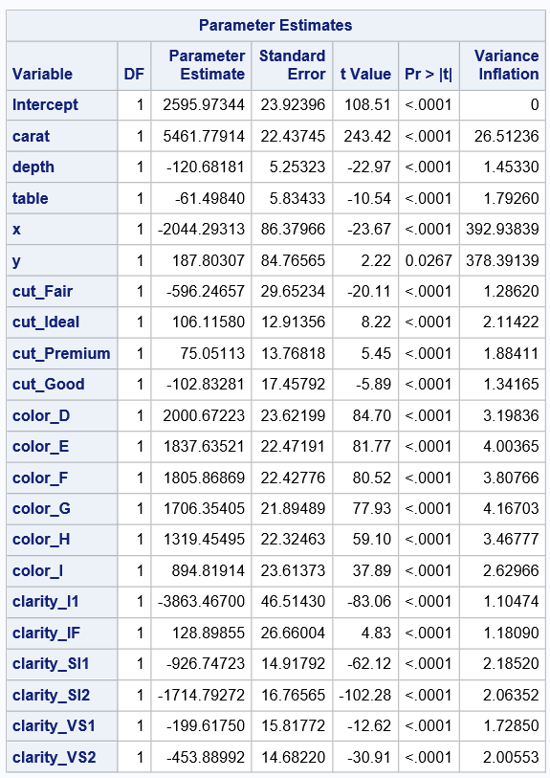
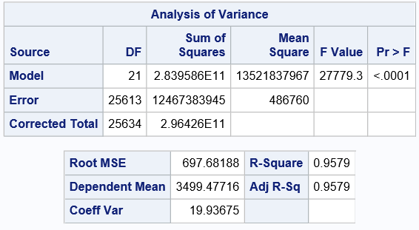
ANALYSIS
STEPWISE SELECTION
From our analysis, we found out that stepwise selection helped us best in feature reduction as it is a combination of both forward and backward elimination.

Slide 23
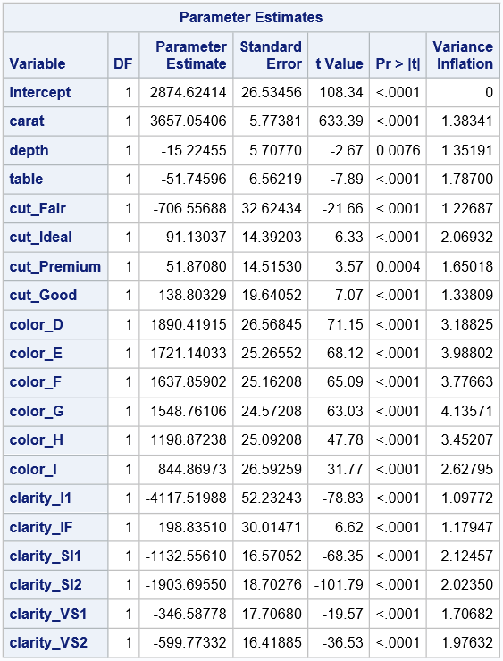
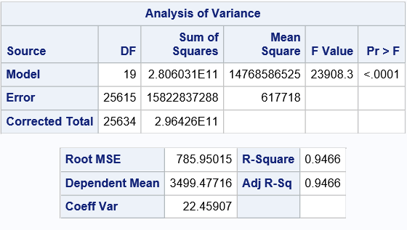
ANALYSIS
STEPWISE SELECTION
This procedure helps us determine the best variables for performing multiple regression.

Slide 24
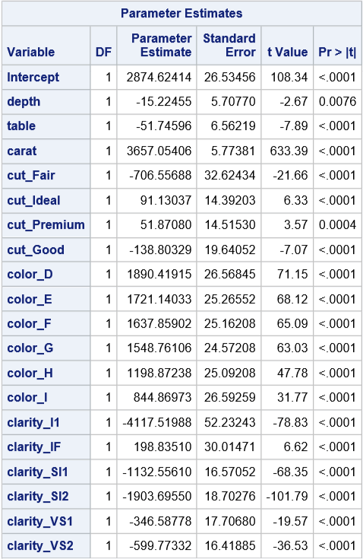
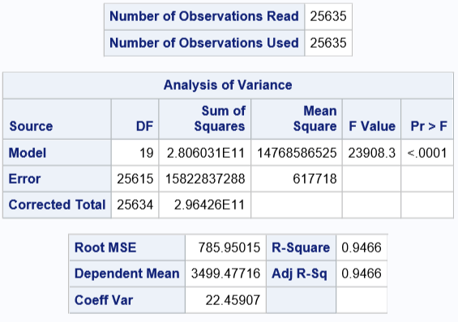
ANALYSIS
MULTIPLE LINEAR REGRESSION
After variable selection run multiple regression with the remaining variables against our target variable.
Our model is significant. And this model has a R-squared value of .9466.

Slide 25
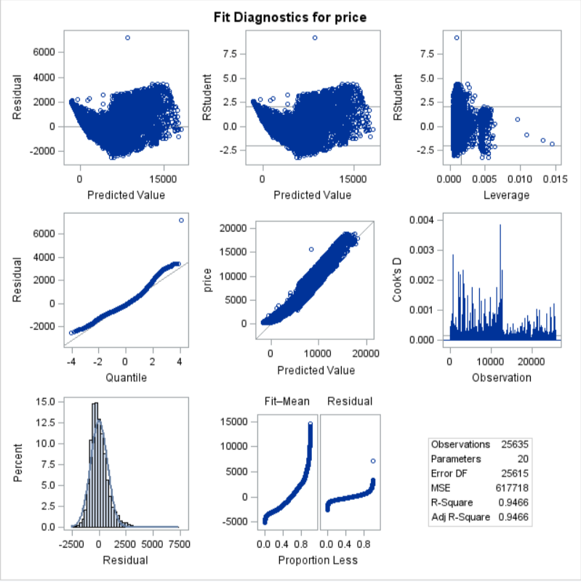
ANALYSIS
MULTIPLE LINEAR REGRESSION
We can observe our residuals here.
The assumptions of multiple linear regression are satisfied by the residuals.

Slide 26
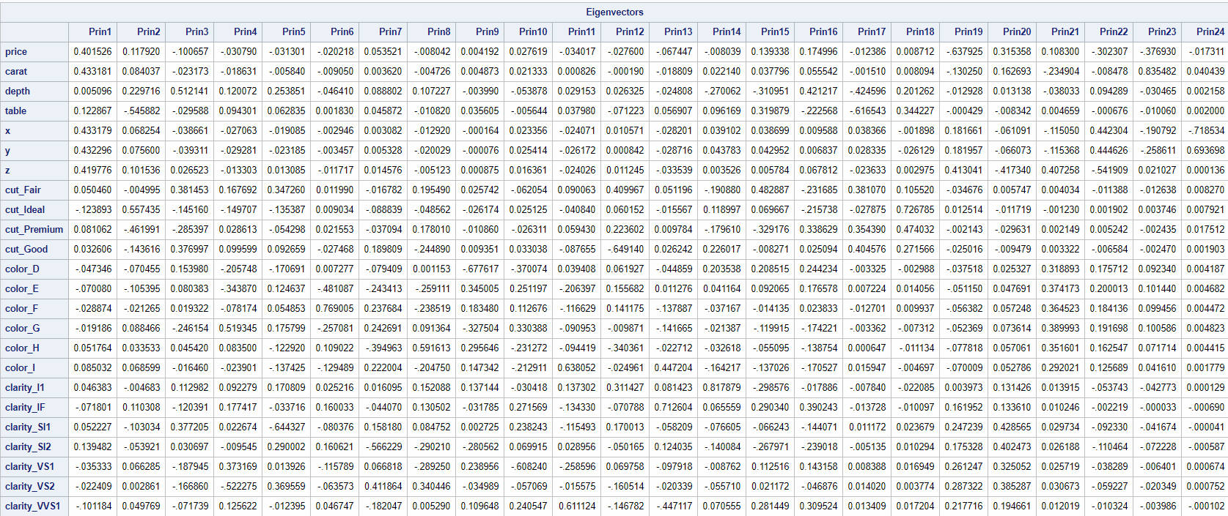
ANALYSIS
PRINCIPAL COMPONENT ANALYSIS

Slide 27
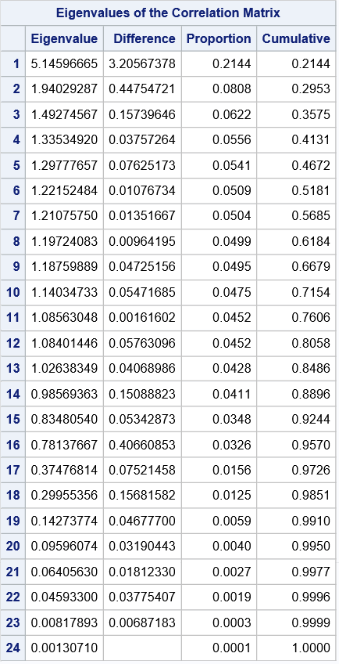
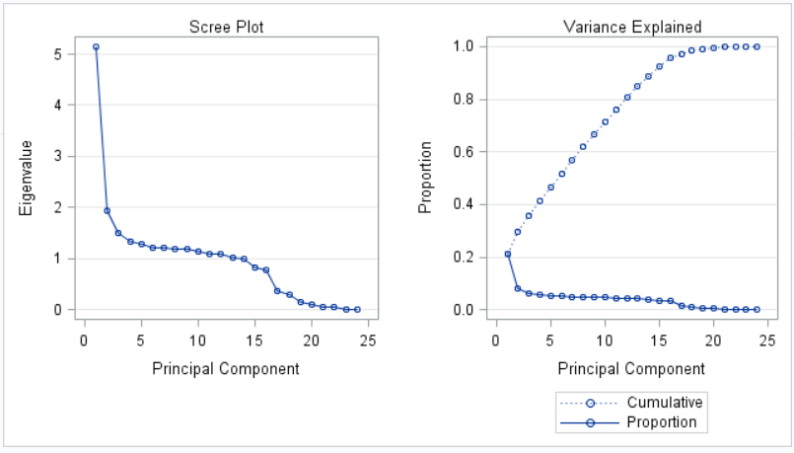
ANALYSIS
PRINCIPAL COMPONENT ANALYSIS

Slide 28
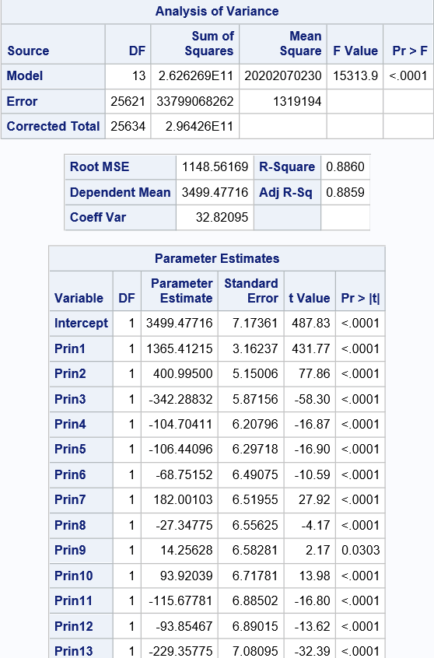
ANALYSIS
REGRESSION USING PRINCIPAL COMPONENTS
In statistics, principal component regression (PCR) is a regression analysis technique that is based on principal component analysis(PCA).
Often the principal components with higher variances (the ones based on Eigen Vectors corresponding to the higher eigenvalues of the sample variance-covariance matrix of the explanatory variables) are selected as regressors.

Slide 29
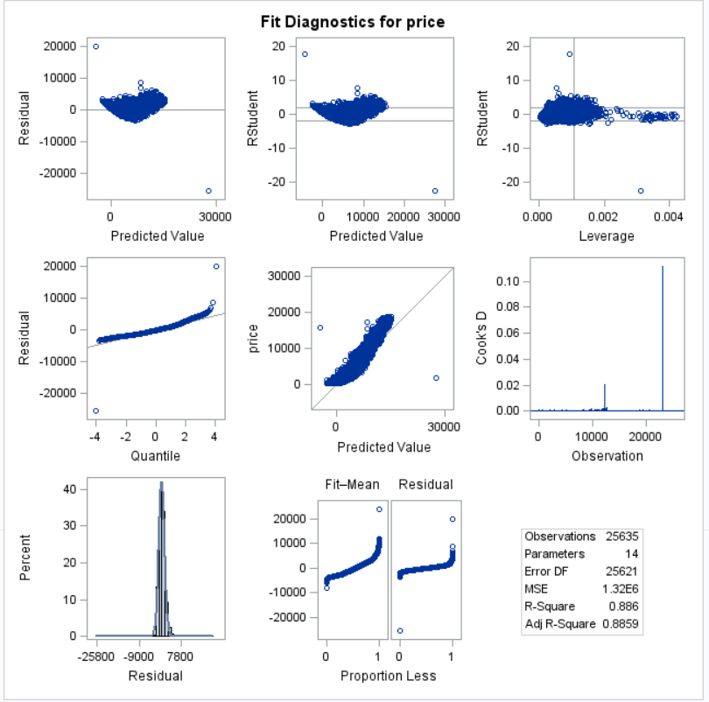
ANALYSIS
REGRESSION USING PRINCIPAL COMPONENTS
We can see our residuals here.
One major use of PCA lies in overcoming the multicollinearity problem which arises when two or more of the explanatory variables are close to being collinear.

Slide 30
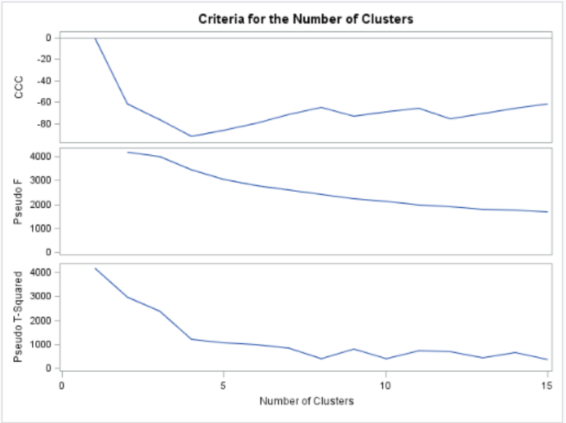
CLUSTERING
K- MEANS CLUSTERING
K-means clustering is one of the simplest and popular unsupervised machine learning algorithms.
The K-means algorithm identifies k number of centroids, and then allocates every data point to the nearest cluster.
The scree plot here shows the optimal number of clusters that has to be created.

Slide 31
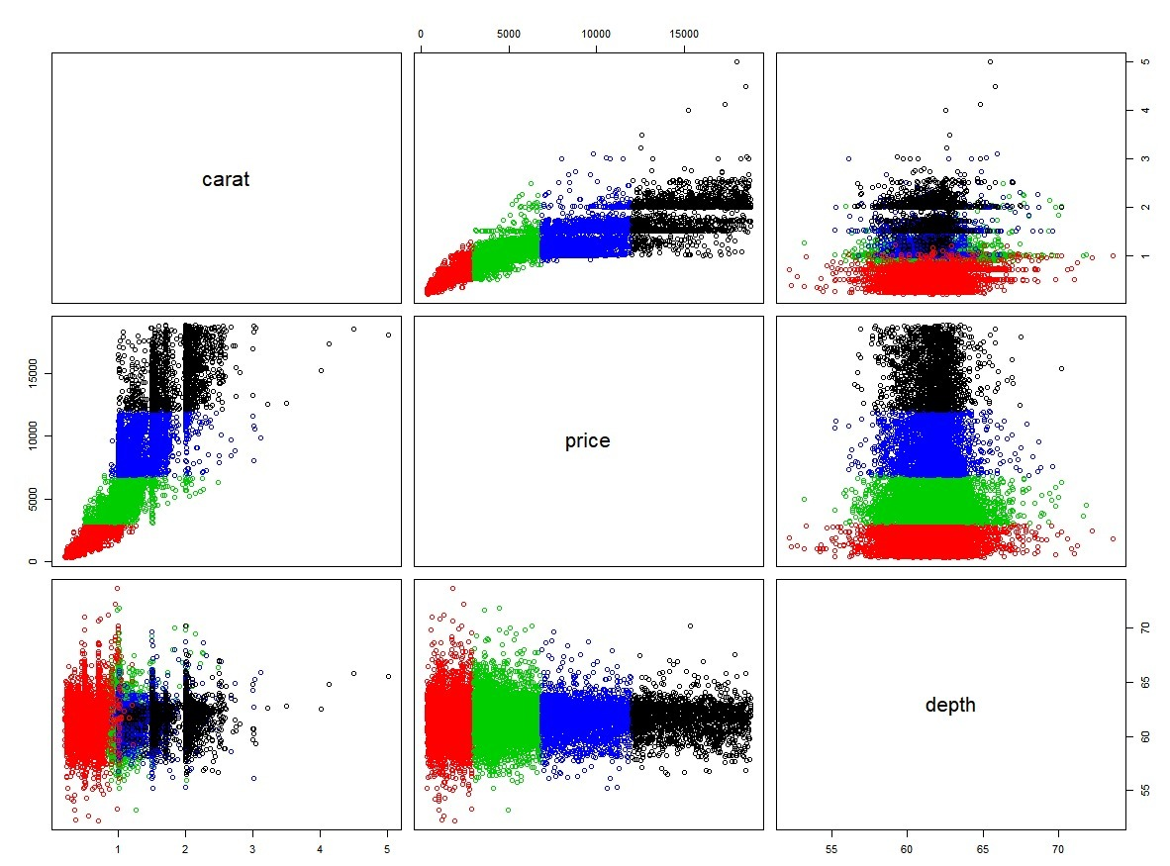
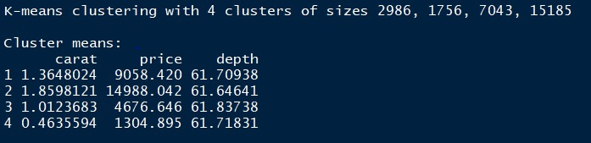
CLUSTERING
From the scree plot we can figure out that 4 clusters is the optimal number of clusters to be created.

Slide 32
CONCLUSION
We performed several different analyses such as feature selection, multiple linear regression, principal component analysis and clustering to try and find the model that can best predict diamond prices.
We also observe from our analysis that the results of the prediction are better without performing PCA. Hence, we recommend that any future models on this dataset be done without using PCA dimensionality reduction.
We found that feature selection combined with multiple linear regression is the most accurate in predicting the price of a diamond using its intrinsic characteristics. Hence, we go ahead with this model for prediction.

Slide 33


THANKS!

